Slide 1
Secure data hiding in images using stenography
CAPSTONE PROJECT
Presented By: Riya Pravin Sutar
Student Name : Riya Pravin Sutar
College Name : : D.Y.Patil College of Engineering, Akurdi
Department : Artificial Intelligence and Data Science

Slide 2
OUTLINE
Problem Statement
Technology used
Wow factor
End users
Result
Conclusion
Git-hub Link
Future scope

Slide 3
Problem Statement
Data security and privacy are critical in the digital world.
Traditional encryption methods can attract attention and be vulnerable to attacks.
Steganography allows secure and discreet communication by hiding sensitive data within images.
The Least Significant Bit (LSB) technique is used to embed secret messages into images.
The goal is to create a user-friendly system for encoding and decoding hidden data without noticeable changes to the image.

Slide 4
Technology used
Libraries & Tools:
Python – Programming language used for implementation
OpenCV – Image processing and manipulation
NumPy – Handling image data as arrays
Tkinter – GUI for user interaction
Platforms:
VS Code – Code development and execution

Slide 5
Wow factors
Unique Features
Enhanced Security – Uses LSB steganography for secure data hiding.
User-Friendly GUI – Simple and interactive Tkinter interface.
Lossless Encoding – Hides messages without significantly altering the image.
Versatile Format Support – Works with multiple image formats (PNG, JPG, etc.).
Efficient Performance – Optimized with OpenCV and NumPy for fast encoding/decoding.

Slide 6
End users
Cybersecurity Professionals – For secure communication and data protection.
Journalists & Whistleblowers – To hide sensitive information from surveillance.
Government & Defense – For confidential data transmission.
Forensic Experts :To embed hidden message in digital evidence.
Healthcare – Secure patient data transmission.
Potential MNCs and Industries like Intel , Google, Microsoft.

Slide 7
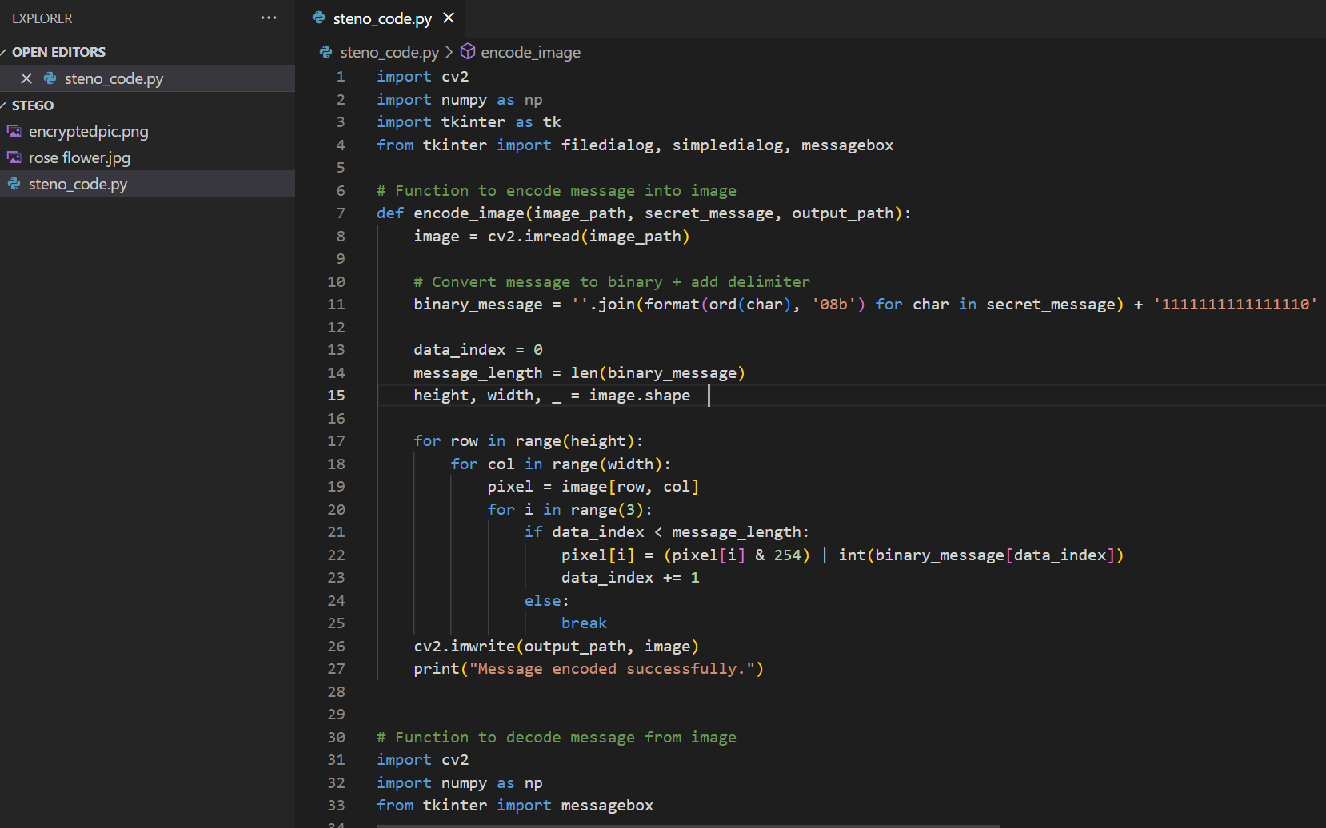

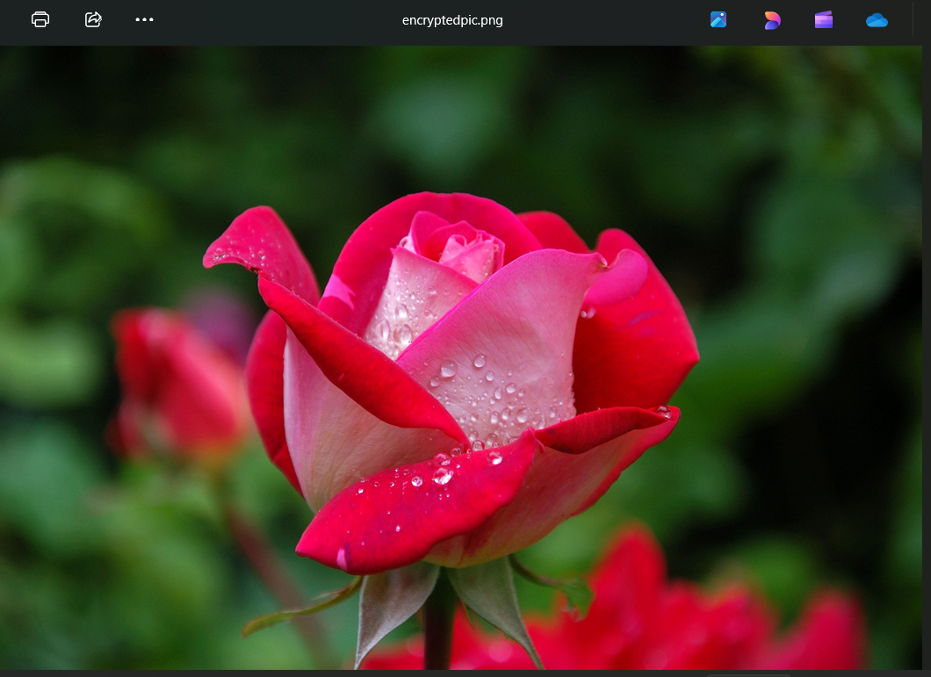
Results
Code
Input Image
Output Image

Slide 8
Conclusion
This project successfully implements image steganography using the LSB technique, ensuring secure message hiding within images. With Python, OpenCV, NumPy, and Tkinter, it provides an easy-to-use interface for encoding and decoding messages.
It enhances data security by keeping confidential information hidden, making it useful in cybersecurity, defense, and digital forensics. Future improvements could include stronger encryption and multi-format support for greater robustness.

Slide 9
GitHub Link
https://github.com/riya3104/Stenography

Slide 10
Future scope(optional)
Support for Multiple File Types: Expanding beyond images to audio, video, and documents for steganography.
AI-Based Detection Resistance: Implementing machine learning to counteract steganalysis tools.
Cloud Integration: Storing and retrieving encoded images from cloud platforms for remote access.
Blockchain for Integrity: Using blockchain technology to verify and track hidden data securely.

Slide 11
THANK YOU

